Slide 1


Implementation of AES Algorithm On All kinds of file
Supervised by:
Promila Haque
Lecturer,
School of Science
Engineering and Technology,
East Delta University (EDU)
Submitted by:
Tarequl Islam
ID: 182001422E
Irfanul Hasan
ID: 182000422E

Slide 2
TABLE OF CONTENTS
01
04
INTRODUCTION
METHODOLOGY
02
05
OBJECTIVE
RESULT / EXAMPLES
03
06
TOOLS USED
CONCLUSION

Slide 3

OBJECTIVE
Implementation of AES algorithm.
Encrypt Text Messages for secure transmission.
Decrypt Encrypted Text Messages with proper key.
Encrypt Confidential Images for secure transmission.
Decrypt Encrypted Images with proper key.
Encrypt any kinds of confidential file.
Decrypt any kinds of confidential file with proper key.
Produce garbage values without right key.

Slide 4

INTRODUCTION
Data is a most important part of our lives. It’s the root of knowledge. But some data in wrong hand can be very dangerous for us. That’s why data security is compulsory. Sometime we need to transfer confidential data through the internet. But internet in full of hackers and eavesdropper. In that case, the best way to secure data is Cryptography. Cryptography is the way to hide information by encryption and decoding it by decryption. The Advanced Encryption Standard (AES) algorithm, also known as the Rijndael algorithm is a symmetrical block cipher cryptographic algorithm that takes plain text and converts them to unreadable format known as cipher text using keys. The cipher text can be converted back to plain text through the process of decryption using same keys. AES encryption used in a lot of ways, including wireless security, processor security, image encryption, file encryption. The NSA (National Security Agency) United States Department of Defence they are using AES to encrypt Top Secret information. So that’s why AES has gained the confidence of various industries. Since the AES algorithm is considered secure, it is in the worldwide standard. In this paper, we will implement AES in Python to encrypt and decrypt any file including text messages, images, voice messages, pdf, documents and any other file formats.

Slide 5






Cryptography
TOOLS USED

Slide 6
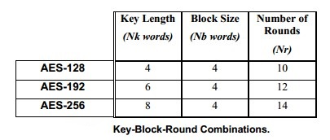
METHODOLOGY
AES Algorithm Specification
The Advanced Encryption Standard (AES) algorithm, also known as the Rijndael algorithm is a symmetrical block cipher cryptographic algorithm that that takes plain text and converts them to unreadable format known as cipher text using keys. The cipher text can be converted back to plain text through the process of decryption using same keys.
AES is divided by two parts:
Cypher / Encryption
Inverse Cypher/ Decryption
For the AES algorithm, the length of the Cipher Key is 128, 192, or 256 bits. The key length is represented by Nk = 4, 6, or 8, which reflects the number of 32-bit words in the Cipher Key. For the AES algorithm, the number of rounds to be performed during the execution of the algorithm is dependent on the key size. The number of rounds is represented by Nr, where Nr = 10 when Nk = 4, Nr = 12 when Nk = 6, and Nr = 14 when Nk = 8. The Key-Block-Round combinations are given in Figure.

Slide 7
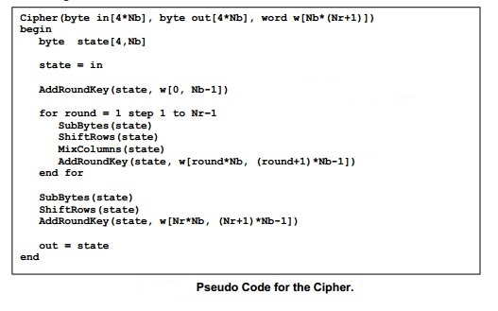
METHODOLOGY
Cipher / Encryption Algorithm
For both its Cipher and Inverse Cipher, the AES algorithm uses a round function that is composed of
four different byte-oriented transformations:
Byte substitution using a substitution table (S-box),
Shifting rows of the State array by different offsets,
Mixing the data within each column of the State array,
Adding a Round Key to the State
The Cipher is described in the pseudo code:
The individual transformations SubBytes() , ShiftRows(), MixColumns(), and AddRoundKey() -process the State and are described next.

Slide 8
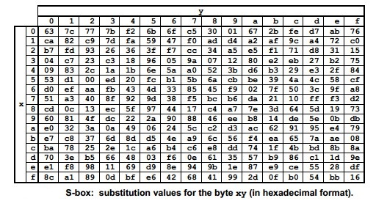
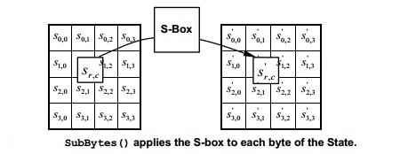
METHODOLOGY
Byte Substitution
The SubBytes() transformation is a non-linear byte substitution that operates independently on each byte of the State using a substitution table (S-Box). This S-box which is invertible, is constructed by composing two transformations:
Take the multiplicative inverse in the finite field (Galoi’s Field) GF(2⁸),
2. Apply the following affine transformation (over GF(2)):

Slide 9
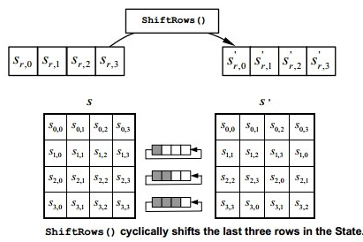
METHODOLOGY
Shifting Rows
In the ShiftRows() transformation, the bytes in the last three rows of the State are cyclically shifted over different numbers of bytes (offsets). The first row, r=0, is not shifted. Specifically, the ShiftRows() transformation proceeds as follows:
where the shift value shift(r,Nb) depends on the row number, r, as follows: shift(1,4) = 1; shift(2,4) = 2 ; shift(3,4) = 3 .
This has the effect of moving bytes to “lower” positions in the row, while the “lowest” bytes wrap around into the “top” of the. Figure illustrates the ShiftRows() transformation:

Slide 10
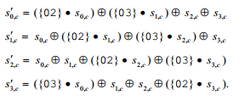
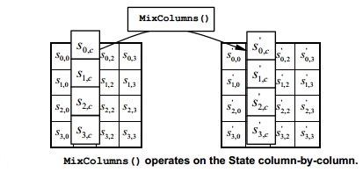

METHODOLOGY
Mixing Columns
The MixColumns() transformation operates on the State column-by-column, treating each column as a four-term polynomial. The columns are considered as polynomials over GF(2⁸) and multiplied modulo x⁴ + 1 with a fixed polynomial a(x), given by,
a(x) = {03} x³ + {01}x² + {01}x + {02} .
This can be written as a matrix multiplication. Let s’(x) = a(x) XOR s(x)
As a result of this multiplication, the four bytes in a column are replaced by the following:

Slide 11
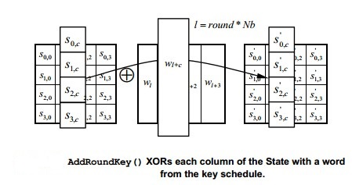
METHODOLOGY
Add Round Key
In the AddRoundKey() transformation, a Round Key is added to the State by a simple bitwise XOR operation. Each Round Key consists of Nb words from the key schedule. Those Nb words are each added into the columns of the State, such that:
Where [w_{i}] are the key schedule words, and round is a value in the range 0 <= round <= Nr. In the Cipher, the initial Round Key addition occurs when round = 0, prior to the first application of the round function. The application of the AddRoundKey() transformation to the Nr rounds of the Cipher occurs when 1 <= round <= Nr.

Slide 12
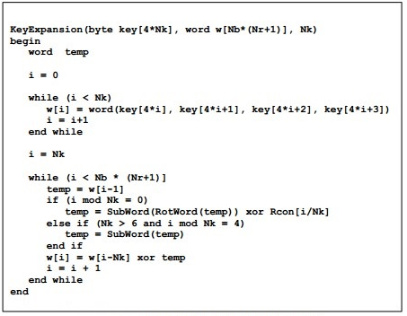
METHODOLOGY
Key Expantion
The AES algorithm takes the Cipher Key, K, and performs a Key Expansion routine to generate a key schedule. The Key Expansion generates a total of Nb*(Nr + 1) words: the algorithm requires an initial set of Nb words, and each of the Nr rounds requires Nb words of key data. The resulting key schedule consists of a linear array of 4-byte words, denoted [w_{i} ], with i in the range 0 <= i < Nb*(Nr + 1).
The expansion of the input key into the key schedule proceeds according to the pseudo code.

Slide 13
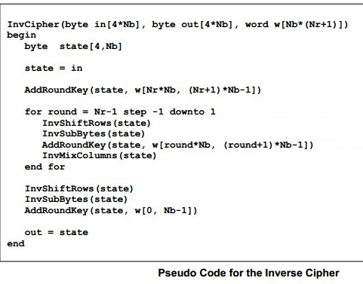
METHODOLOGY
Inverse Cipher / Decryption Algorithm
The Cipher transformations can be inverted and then implemented in reverse order to produce a straightforward Inverse Cipher for the AES algorithm. The individual transformations used in the Inverse Cipher - InvShiftRows(), InvSubBytes(), InvMixColumns(), and AddRoundKey() –process are just inverted form of previously discussed functions.
The Inverse Cipher is described in the pseudo code in Fig:

Slide 14


Experimental Results / Examples
Text
Image
Other

Slide 15
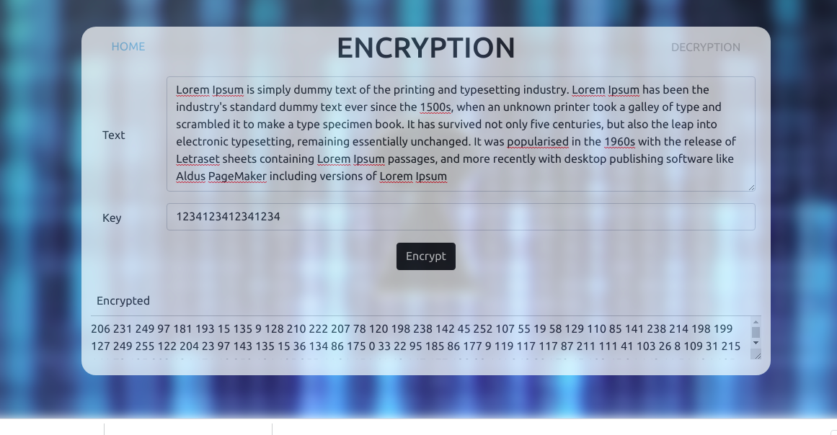
Experimental Results / Examples

Slide 16
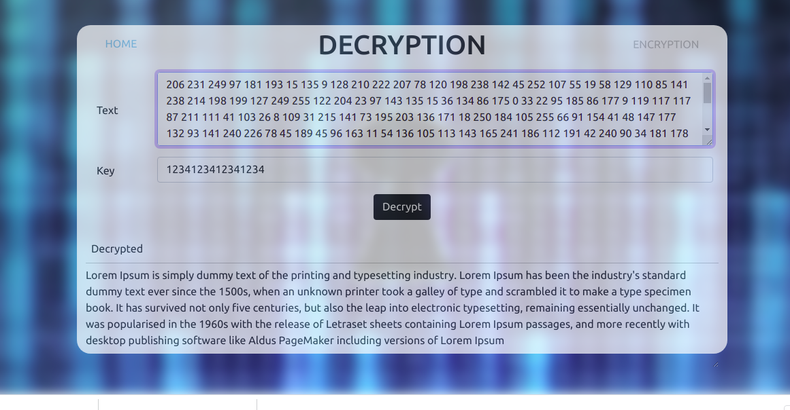
Experimental Results / Examples

Slide 17
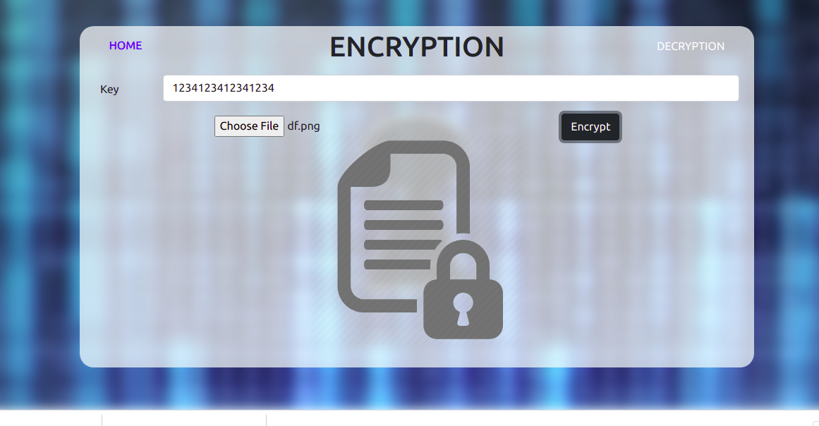
Experimental Results / Examples

Slide 18
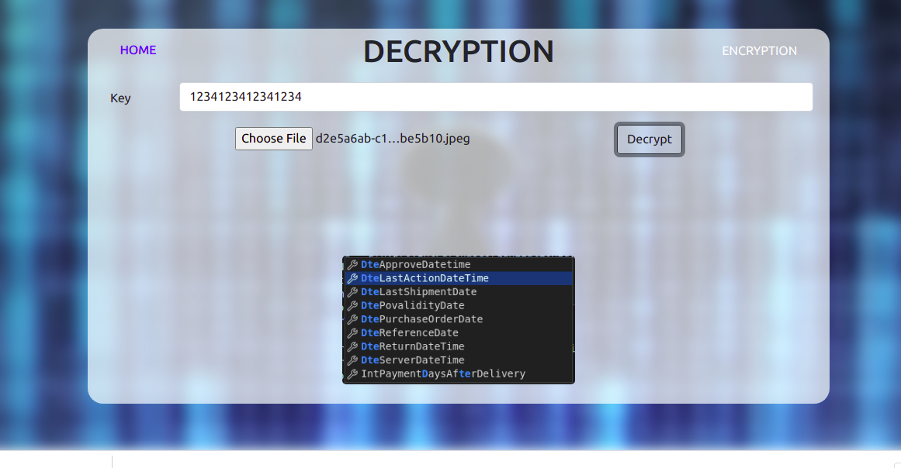
Experimental Results / Examples

Slide 19
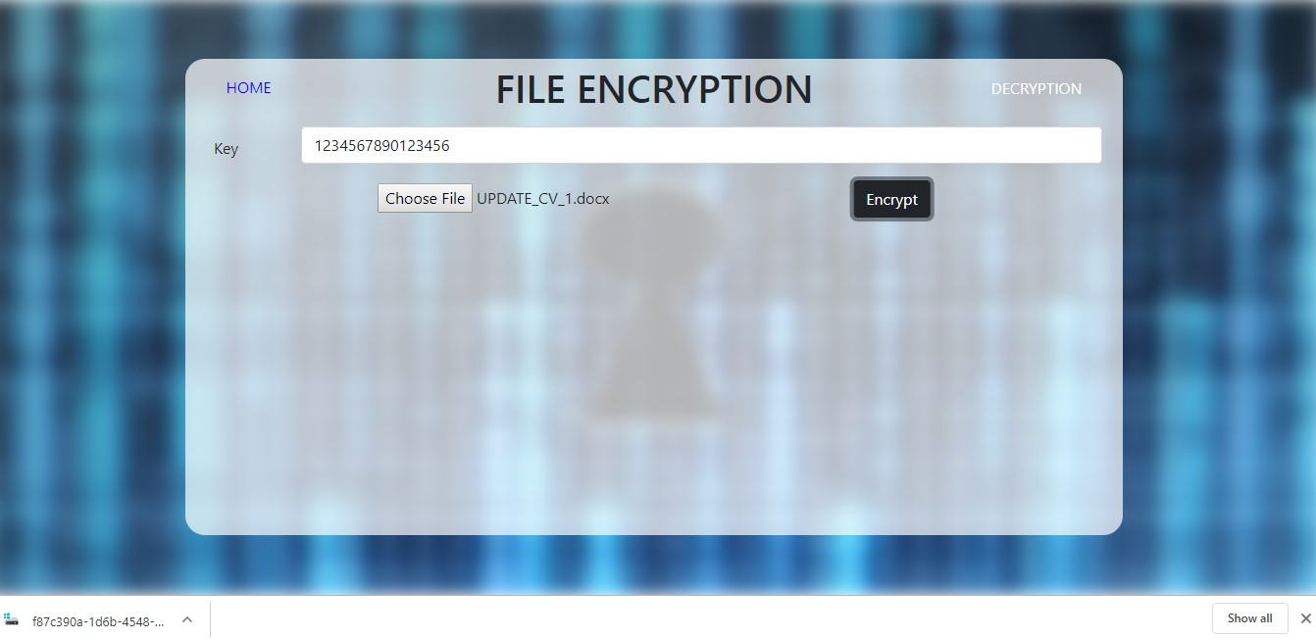
Experimental Results / Examples

Slide 20
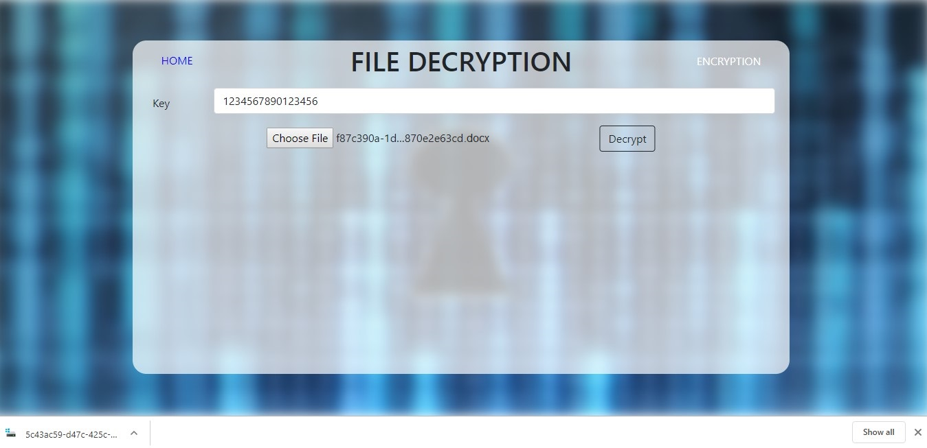
Experimental Results / Examples

Slide 21

CONCLUSION
In this project, we have implemented AES algorithm in python and built a system to secure data for online transmission. In our project we can encrypt text messages, images, voice messages, documents and any other types of files. And also decrypt text messages, images, voice messages, documents and any other types of files with proper keys. Without the right keys, no one can extract any information from the encrypted files.

Slide 22

THANKS!
Do you have any question?
Contact:dyou
182001422e@eastdelta.edu.bdfreepik.com
182000422e@eastdelta.edu.bd

